Slide 1
An Introduction to Local Search
Shaowei Cai
Chinese Academy of Sciences
2016

Slide 2
Outline of this chapter
Combinatorial Optimization and Heuristic Search
Local Search Methods
Algorithmic Techniques
A Detailed Study: Configuration Checking
The Local Search Book
Stochastic Local Search: Foundation and Applications, 2004

Slide 3
Combinatorial Optimization and Heuristic Search

Slide 4

Minimum Vertex Cover
Given a graph G=(V,E)
A vertex cover is a vertex subset C such that every edge in G has at least one vertex in C.
Problem: Find a vertex cover with the minimum size, i.e., cover all edges with the least vertices.
Applications: Monitoring link failures in network (at which nodes of the network to put the monitor, so that we can know all the status of the every linkage)

Slide 5
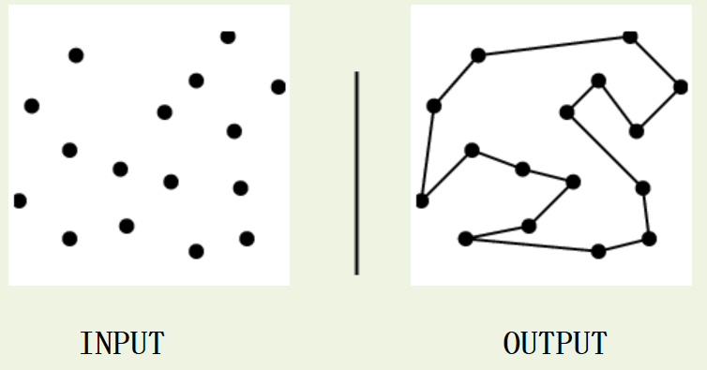
Traveling Salesman Problem
Input: A weighted graph G.
Problem: Find the cycle of minimum cost visiting all of the vertices of G exactly once.
Application: optimizing the paths for manufacturing equipment. For example, consider a robot arm assigned to solder all the connections on a printed circuit board. The shortest tour that visits each solder point exactly once defines the most efficient path for the robot.

Slide 6
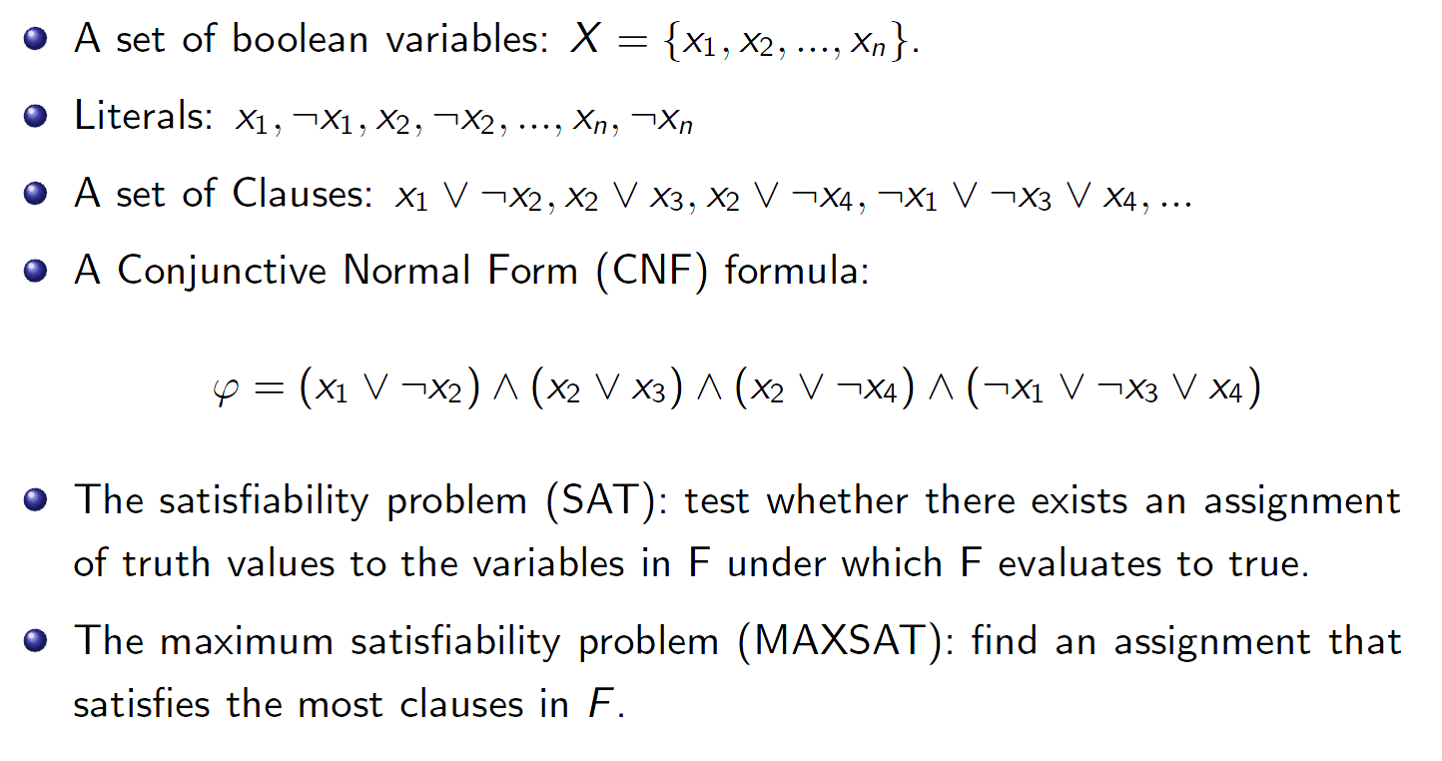
SAT and MaxSAT

Slide 7
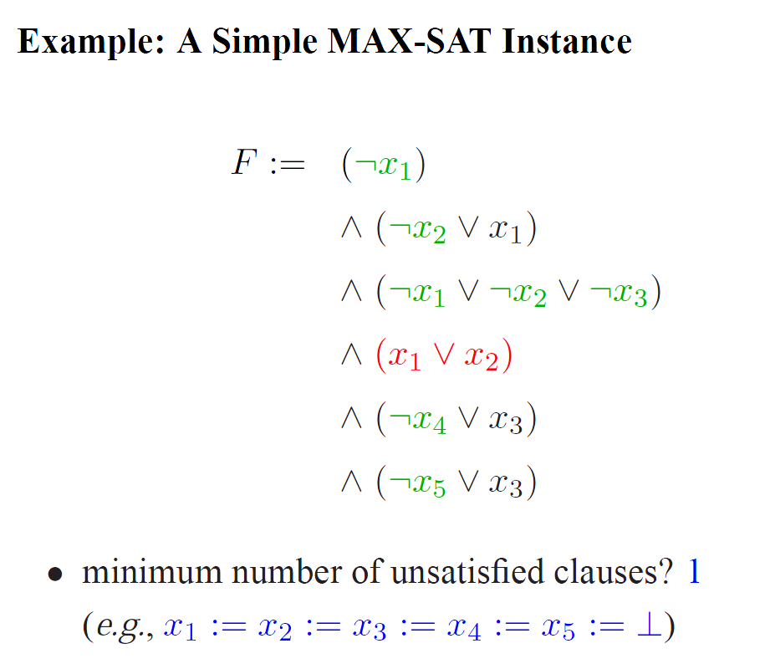
A MaxSAT Instance

Slide 8
Combinatorial Problems
Combinatorics is a branch of mathematics concerning the study of finite or countable discrete structures.
Combinatorial problems…
involve finding a solution (can be subset, ordering, or assignment etc.) for a set of discrete objects which satisfies certain constraints
arise in many domains of computer science and various application areas
Combinatorial problems
Combinatorial decision problems
Combinatorial optimization problems
The decision and optimization versions of the same combinatorial problem can be easily transfered to each other. Combinatorial optimization is more often mentioned and studied.

Slide 9
Combinatorial Problems
More combinatorial problems:
maximum clique
vertex coloring
planning, scheduling, time-tabling
resource allocation
protein structure prediction
genome sequence assembly

Slide 10
Combinatorial Optimization is Hard
Many Combinatorial Optimization problems usually have high computational complexity (NP-hard)
Intuitively, NP is the set of all decision problems for which the “yes”-instances have efficiently verifiable proofs. More precisely, these proofs have to be verifiable in polynomial time by a deterministic Turing machine.
In an equivalent formal definition, NP is the set of decision problems where the "yes"-instances can be accepted in polynomial time by a non-deterministic Turing machine.
The complexity class P is contained in NP; the hardest problems in NP are called NP-complete problems.
P=?NP is the most important open question in computer science.
NP-hardness is a class of problems that are, informally, "at least as hard as the hardest problems in NP".

Slide 11
Tackling Hard Combinatorial Optimization
Computational complexity tells us that many combinatorial optimization problems are NP-hard.
This is established on the worst case complexity.
Tackle hard combinatorial optimization problems
Some subclasses of the problem can be easy
Approximation algorithms
Randomized (probabilistic) algorithms
Parameterized algorithms
Heuristic algorithms
In practice, hard combinatorial optimization problems are usually solved using heuristic search algorithms.

Slide 12
What is Heuristic?
"The name heuristics applies to every rule, conclusion, evaluation, and principle that works in certain situations most of the time, but not always."
"The word comes from Archimedes' famous exclamation when in the bath it suddenly struck him how he could decide whether King Hieron's crown was made of real gold or not. Screaming "heureka" (I got it, I found it), Archimedes ran naked along the main street of Syracuse to make the test as soon as possible."
"At every moment man applies heuristic procedures in almost all his trains of thought, as this is the only way he can act appropriately within a reasonable time without thinking over the host of possibilities with all their consequences and all the possible consequences of the consequences. Artificial Intelligence also needs heuristics, because thinking over all the branches of the chains of reasoning is mostly impossible even by the fastest computers."
---from "Ways of Thinking: The Limits of Rational Thought and Artificial Intelligence"

Slide 13
Search Methods
Types of search methods:
systematic search ←→ local search
Complete ←→ incomplete
deterministic ←→ stochastic
sequential ←→ parallel

Slide 14
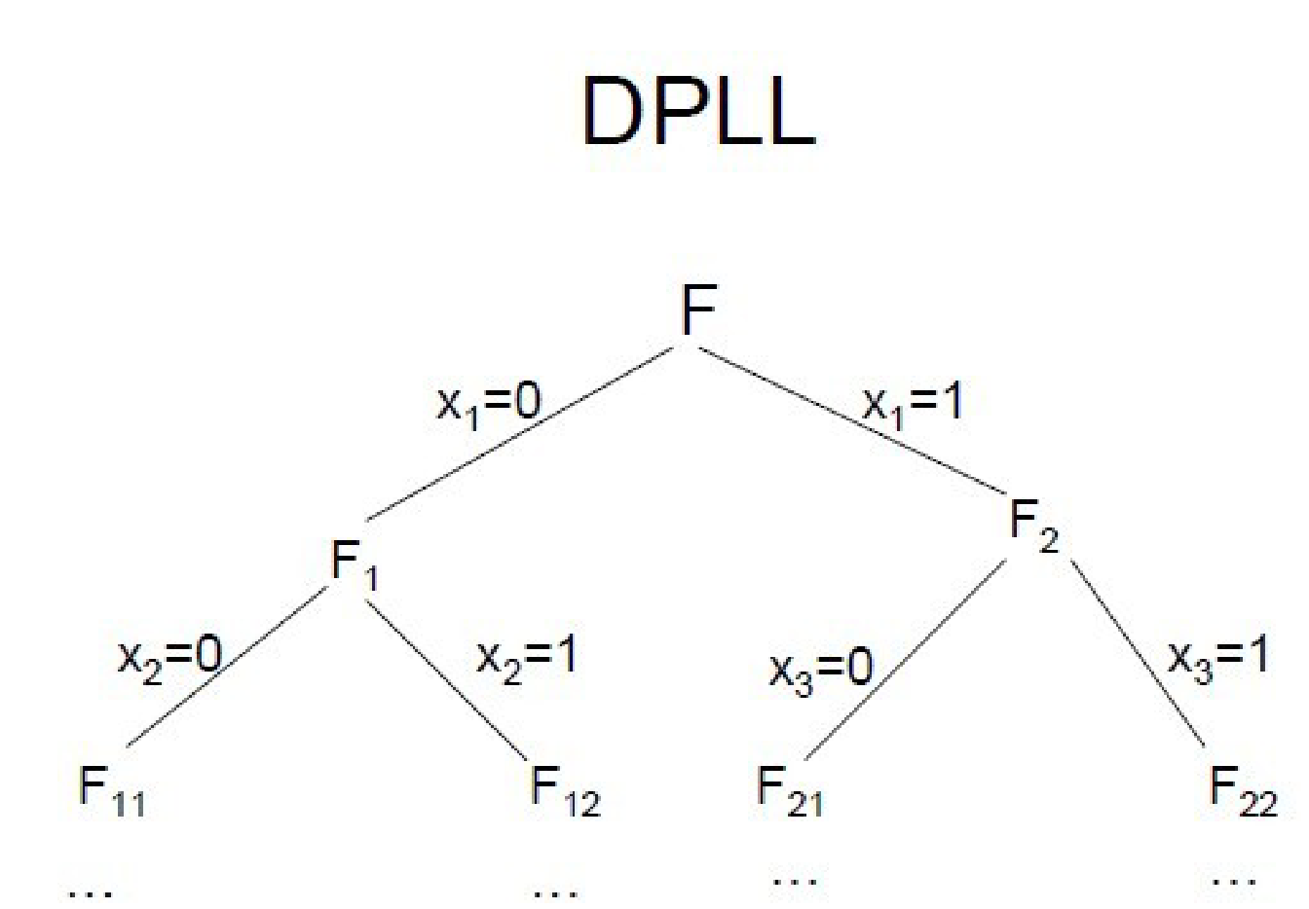
Systematic Search
Types of search methods:
Complete ←→ incomplete
systematic search ←→ local search
deterministic ←→ stochastic
sequential ←→ parallel

Slide 15
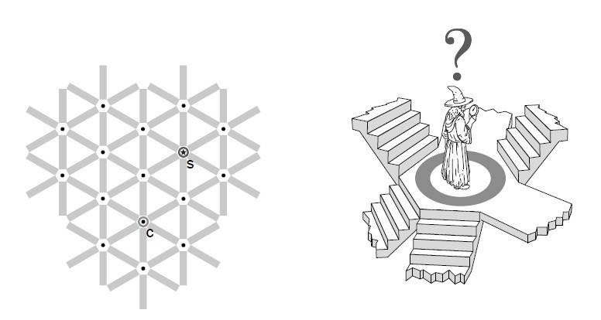
Local Search

Slide 16
Heuristic Search
Most heuristic alorithms are local search, stochastic, and incomplete.
However, complete algorithms might use heuristics too. Can we say they are heuristic? Does it depend on how many heuristic techniques it uses?
It is hard to give a clear definition for heurisitc search.
Personal viewpoint: Heuristic search algorithms are search algorithms that uses heuristics. Any kind of search algorithms can be heuristic. But one may not like to emphasize it for those using only slight heuristics.

Slide 17
Local Search

Slide 18
A Quick Glance at Local Search
A SAT/MaxSAT instance
F={x₁ \/ ~x₂, x₁ \/ x₂, x₂, ~x₁ \/ x₂ \/~x₃}
Starting with a rough first guess, small changes are repeatedly performed on a given candidate solution with the goal of improving its quality or of getting closer to a solution.
From one candidate solution to another candidate solution.
Local search algorithms usually treat SAT as a MaxSAT problem
 | assignment | unsatisfied clauses
initial | 000 | x₁ \/ x₂, x₂
Step 1 | 100 | x₂
Step 2 | 110 | None （optimal）

Slide 19
Example Problem: SAT/MaxSAT
Why choose SAT as example problem
The first NP-Complete problem [1971]
Conceptually simple and easy to describe
Many successful algorithmic techniques
Many theoretical results
Many important applications
The most studied problem in the field of algorithms
Open source benchmarks and solvers
Annual competition
...

Slide 20
Local Search (LS) Algorithms
search space S
(SAT: set of all complete truth assignments to propositional variables)
solution set S′ ⊆ S
(SAT: models of given formula)
neighbourhood relation N ⊆ S × S
(SAT: neighbouring variable assignments differ in the truth value of exactly one variable)
evaluation function g : S → R⁺
(SAT: number of clauses unsatisfied under given assignment)

Slide 21
Local Search (LS) Algorithms
search space S
(MaxSAT: set of all complete truth assignments to propositional variables)
solution set S′ ⊆ S
(MaxSAT: S'=S)
neighbourhood relation N ⊆ S × S
(MaxSAT: neighbouring variable assignments differ in the truth value of exactly one variable)
objective function f : S → R⁺
(MaxSAT: number of clauses unsatisfied under given assignment)
evaluation function g : S → R⁺
(MaxSAT: g1=number of clauses unsatisfied under given assignment;
g2=total weight of clauses unsatisfied under given assignment,using clause weighting techniques.)

Slide 22
A geometrical veiwpoint of Local Search:
the whole search space forms a network
a local search algorithm starts from an initial position (corresponding to an initial candidate solution);
iteratively moves from the current position to neighbouring position
use evaluation function for guidance
Two important factors in local search design
Neighbourhood relation
Evaluation function

Slide 23
Pros. and Cons. of Local Search
Pros:
Conceptually simple and esay to implement
Generic purpose
Scalability ( suitably efficient and practical when applied to large situations )
for many combinatorial problems more efficient than systematic search
Easy to parallelize
Cons
often incomplete (no guarantees for solution quality)
usually stochastic behaviour
often difficult to analyze theoretically

Slide 24
When to use Local Search
When you meet these scenarios, try local search
Know little about the problem
Approximate solutions are acceptable
Time resource is limited or very valuable
The instance is very large

Slide 25
A Simple Local Search
Iterative Improvement (Greedy Search):
initialize search at some point of search space
in each step, move from the current search position to a neighbouring position with a better evaluation function value

Slide 26
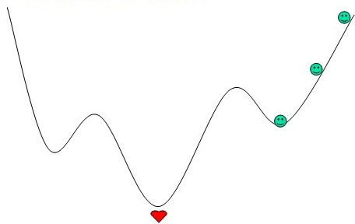
Typical problems with local search:
getting stuck in local optima
being misguided by evaluation function

Slide 27
Note:
Local minima depend on g and neighbourhood relation, N.
Larger neighbourhoods N(s)
neighbhourhood graphs with smaller diameter, i.e. max_{u,v}d(u,v);
fewer local minima.
more costly to be search.
Exteme case: exact neighbourhood
for which any local optimum is also guaranteed to be a global optimum.
exact neighbourhoods are too large to be searched effectively (exponential in size of problem instance).

Slide 28
Stochastic Local Search:
randomize initialization step
random initial solutions
randomized construction heuristics
randomize search steps
such that suboptimal/worsening steps are allowed
improved performance & robustness
typically, degree of randomization controlled by probability parameter

Slide 29
Simple SLS methods
Random Search (Blind Guessing):
In each step, randomly select one element of the search space.
(Uninformed) Random Walk:
In each step, randomly select one of the neighbouring positions of the search space and move there.

Slide 30
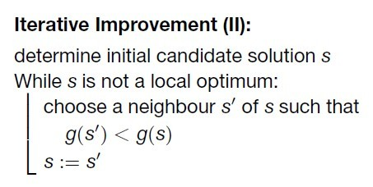

Slide 31
Iterative Improvement for MaxSAT
initialization: randomly chosen complete truth assignment
neighbourhood: variable assignments are neighbours iff they differ in truth value of one variable
neighbourhood size: O(n) where n = number of variables
evaluation function g: number of clauses unsatisfied under given assignment

Slide 32
Iterative Improvement for MaxSAT
S := a random complete assignment;
while (1)
if (exist S' N(S) s.t. g(S')<g(S) )
S' = such an assignment;
S := S';
else
return S;
Note: here we assume evalution function g is the number of unsatisfied clauses under the assignment.

Slide 33
run a small example
Neighbourhood relation: two assignments are neighbors if and only if they differ in the truth value of exactly one variable
S=<000>, N(S)={S1,S2,S3}={<100>,<010>,<001>}
g(S)=2
g(S1) =1
g(S2) =1
g(S3) = 2
In iterated improvement, the algorithm moves from S to which assignment?
F={x₁ \/ ~x₂, x₁ \/ x₂, x₂, ~x₁ \/ x₂ \/~x₃}
 | assignment | unsatisfied clauses
S | 000 | x₁ \/ x_{2,} x₂

Slide 34
Score of Variables
In SAT/MaxSAT, we can define a score for each variable.
Under assignment S, score(x) = g(S)-g(S'), where S' differs from S only in the value of x. This is a scoring function of variables.
score(x₁)=g(000) - g(100)=2-1=1
score(x₂)=g(000) - g(010) = 2-1=1
score(x₃)=g(000) - g(001) = 2-2=0
F={x₁ \/ ~x₂, x₁ \/ x₂, x₂, ~x₁ \/ x₂ \/~x₃}
 | assignment | unsatisfied clauses
S | 000 | x₁ \/ x_{2,} x₂

Slide 35
Score of Variables
In SAT/MaxSAT, we can define a score for each variable.
Under assignment S, score(x) = g(S)-g(S'), where S' differs from S only in the value of x. This is a scoring function of variables.
score(x₁)=g(100) - g(000)=1-2=-1
score(x₂)=g(100) - g(110) =1-0=1
score(x₃)=g(100) - g(101) =1-2=-1
F={x₁ \/ ~x₂, x₁ \/ x₂, x₂, ~x₁ \/ x₂ \/~x₃}
 | assignment | unsatisfied clauses
S | 000 | x₁ \/ x_{2,} x₂
S | 100 | x₂

Slide 36
Score of Variables
In SAT/MaxSAT, we can define a score for each variable.
Under assignment S, score(x) = g(S)-g(S'), where S' differs from S only in the value of x. This is a scoring function of variables.
F={x₁ \/ ~x₂, x₁ \/ x₂, x₂, ~x₁ \/ x₂ \/~x₃}
 | assignment | unsatisfied clauses
S | 000 | x₁ \/ x_{2,} x₂
S | 100 | x₂
S | 110 | _{None}

Slide 37
Iterative Improvement for MaxSAT
S := a random complete assignment;
while (1)
if (exist variables with positive score)
x := a variable with positive score;
S := S with x flipped;
else
return S;

Slide 38
Iterative Improvement for MaxSAT
S := a random complete assignment;
while (1)
if (exist variables with positive score)
x := a random variable with positive score;
S := S with x flipped;
else
return S;

Slide 39
Iterative Improvement for MaxSAT
S := a random complete assignment;
while (1)
if (exist variables with positive score)
x := a variable with the best positive score;
S := S with x flipped;
else
return S;

Slide 40
Invariant of Iterative Improvement for SAT
GSAT [Selman et al, AAAI 1992]
S := a random complete assignment;
while (!termination condition)
if (S is a solution) return S;
x := a variable with the best score;
S := S with x flipped;
return S;

Slide 41
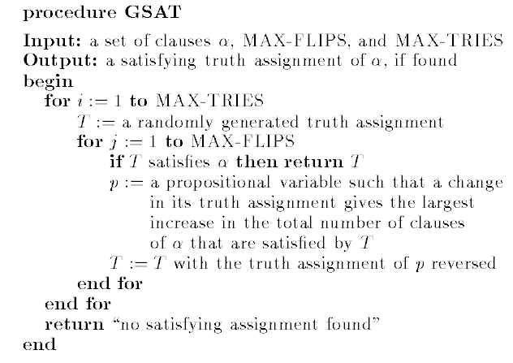
GSAT, from paper [Selman, et al, 1992]

Slide 42
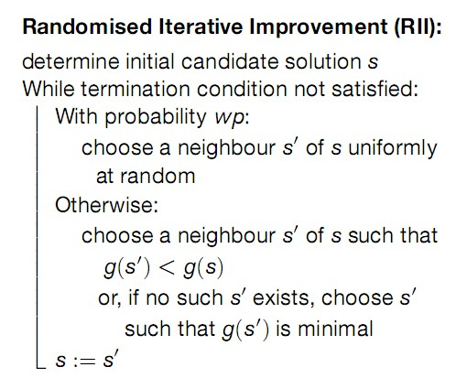

Slide 43
GWSAT [Bart Selman and Henry Kautz, 1993]
search steps:
– with probability p, choose a variable appearing in
an unsatisfied clause randomly
– otherwise, select a variable with the best score

Slide 44
General SLS Framework
procedure SLS-Decision(π)
input: problem instance π ∈ Π
output: solution s ∈ S(π) or ∅
(s) := init(π);
while not terminate(π, s) do
s := step(π, s);
if s ∈ S(π) then
return s
else
return ∅
procedure SLS-Minimization(π)
input: problem instance π ∈ Π
output: solution s ∈ S(π) or ∅
(s) := init(π);
s* := s;
while not terminate(π, s) do
s := step(π, s);
if f(π, s) < f(π, s*)
s* := s;
if s* ∈ S(π) then
return s*
else
return ∅
why? when can be ommitted?

Slide 45
Simple SLS Methods
Simple SLS Methods
Random Walk(RW) (recall)
Iterative Improvement(II) and Randomized Iterative Improvement(RII) (recall)
Variable Neighbourhood Descent (VND)
Simulated Annealing(SA)

Slide 46
Trade-off in Local Search
An example trade-off:
Using larger neighbourhoods can improve performance of II(and other SLS methods).
But: time required for determining improving search steps increases with neighbhourhood size.
More general trade-off:
Effectiveness vs time complexity of search steps.

Slide 47
Variable Neighbourhood Descent
Recall: Local minima are relative to neighbourhood relation.
Key idea: To escape from local minimum of given neighbourhood relation, switch to different neighbhourhood relation.
Use k neighbourhood relations N₁, . . . ,N_{k} , (typically) ordered according to increasing neighbourhood size.
Always use smallest neighbourhood that facilitates improving steps.

Slide 48
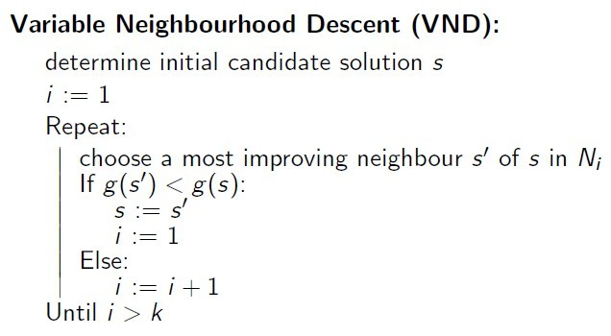

Slide 49
Think about it? How to design a VND for MaxSAT
How to define neighbourhood relations N₁, . . . ,N_{k} ?
When to use a larger neighbourhood?

Slide 50
Note:
VND often performs substantially better than simple II or II in large neighbourhoods [Hansen and Mladenovi´c, 1999]
Many variants exist that switch between neighbhourhoods in different ways.
More general framework for SLS algorithms that switch between multiple neighbourhoods: Variable Neighbourhood Search (VNS) [Mladenovi´c and Hansen, 1997].

Slide 51
Simulated Annealing
Combinatorial search technique inspired by the physical
process of annealing [Kirkpatrick et al. 1983, Cerny 1985]
Outline
generate a neighbour solution / state
probabilistically accept the solution / state
probability of acceptance depends on the objective function (energy function) difference and an additional parameter called temperature

Slide 52
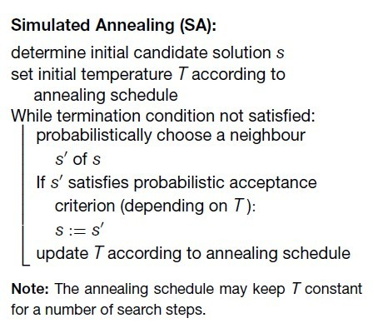

Slide 53
Solution generation
typically returns a random neighbouring solution
Acceptance criterion
Metropolis acceptance criterion
better solutions are always accepted
worse solutions are accepted with probability
∼ exp{[g(s) − g(s′)]/T}
Annealing
parameter T, called temperature, is slowly decreased

Slide 54
Generic choices for annealing schedule
initial temperature T₀
(example: based on statistics of evaluation function)
cooling schedule— how to change temperature over time
(example: geometric cooling, T_{n+1} = a· T_{n}, n = 0, 1, . . .)
number of iterations at each temperature
(example: multiple of the neighbourhood size)
stopping criterion
(example: no improved solution found for a number of temperature values; time limit.)

Slide 55
Hybrid SLS Methods
Hybrid SLS Methods
Iterated Local Search
Greedy Randomized Adaptive Search

Slide 56
Note: Many of the best-performing SLS algorithms
are combinations of various simple local search
strategies.
Simple examples:
Commonly used restart mechanisms can be seen as hybridizations with Uninformed Random Picking
Iterative Improvement + Uninformed Random Walk = Randomized Iterative Improvement
conceptual separation of simple search
strategies and (higher-level) search control

Slide 57
Iterated Local Search
Key Idea: Use two types of search steps:
subsidiary local search steps for reaching local optima as efficiently as possible (intensification)
perturbation steps for effectively escaping from local optima (diversification).

Slide 58
Iterated Local Search for SAT
S := a random complete assignment;
while (!termination condition)
if (exsit variables with positive score)
x:= a variable with positive score;
S := S with x flipped.
else
make changes on S randomly.

Slide 59
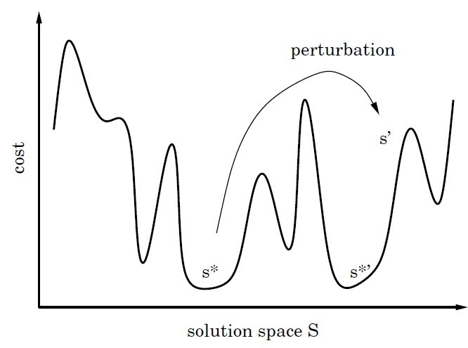
Subsidiary local search results in a local minimum.
ILS trajectories can be seen as walks in the space of
local minima of the given evaluation function.
Pictorial representation of iterated local search.

Slide 60
Trade-off in Local Search
Another trade-off:
trade off between intensification (greediness) and diversification (perburtation).
what if the search is too intensified?
what if the search is too diversified?

Slide 61
Trade-off in Local Search
Another trade-off:
trade off between intensification (greediness) and diversification (perburtation).
what if the search is too intensified?
easily get trapped in local optimum
what if the search is too diversified?
too much guess, could not get to good local optimum
This is an important trade-off in local search

Slide 62
Greedy Randomized Adaptive Search
Key Ideas:
Greedy construction search finds high-quality solutions, and then apply local search.
Unfortunately, greedy construction search only generates a very limited number of different candidate solutions.
→ GRASP try to avoid this disadvantage by randomizing the construction method

Slide 63
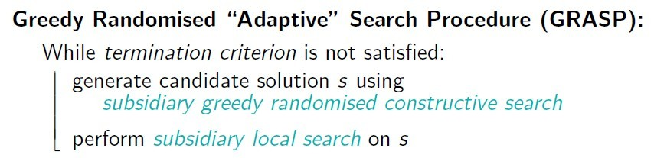
the constructive search algorithm used in GRASP does not necessarily choose a variable with maximal heuristic value in each construction step, but rather selects randomly from a set of highly ranked solution components.

Slide 64
Restricted candidate lists (RCLs)
Each step of constructive search adds a solution component selected uniformly at random from a restricted candidate list(RCL).
RCLs are constructed in each step using a heuristic function h.
RCLs based on cardinality restriction comprise the k best-ranked solution components. (k is a parameter of the algorithm.)

Slide 65
GRASP for SAT [Resende and Feo, 1996]
Subsidiary constructive search:
start from empty variable assignment
in each step, assign a currently unassigned variable
heuristic function h(i , v) := number of clauses that become satisfied by assigning x_{i} := v
RCLs based on cardinality restriction (contain fixed number k of atomic assignments with largest heuristic values)
Subsidiary local search:
iterative best improvement using 1-flip neighbourhood
terminates when model has been found or given number of steps has been exceeded

Slide 66
Population based SLS Methods
SLS methods discussed so far manipulate one candidate solution of given problem instance in each search step.
Straightforward extension: Use population (i.e., set) of candidate solutions instead.

Slide 67
Population-based SLS Methods
Evolutionary Algorithms
Ant Colony Optimization

Slide 68
Evolutionary Algorithms
Key idea: Iteratively apply genetic operators mutation, recombination, selection to a population of candidate solutions.
Inspired by simple model of biological evolution:
Mutation introduces random variation in the genetic material of individuals.
Recombination of genetic material during sexual reproduction produces offspring that combines features inherited from both parents.
Differences in evolutionary fitness lead selection of genetic traits (‘survival of the fittest’).

Slide 69
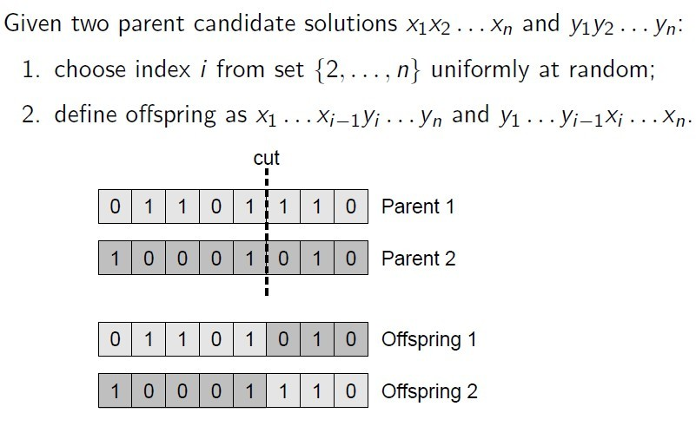
Recombination

Slide 70
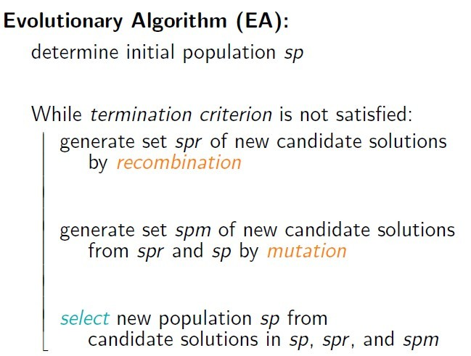

Slide 71
Problem: Pure evolutionary algorithms often lack capability of sufficient search intensification.
Solution: Apply subsidiary local search after initialization, mutation and recombination.
=> Memetic Algorithms

Slide 72
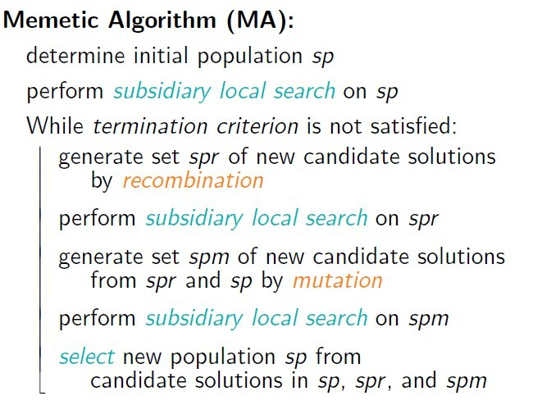

Slide 73
Example: A memetic algorithm for SAT (1)
Represent: truth assignments can be naturally represented as bit strings.
Use 1-flip neighbourhood relation;
Evaluation function: number of unsatisfied clauses.
Use population of k truth assignments;
initialize by (independent) Uninformed Random Picking.

Slide 74
Example: A memetic algorithm for SAT (2)
Recombination: Generate offspring by binary crossovers on pairs of randomly selected assignments; offsprings are added to current population.
Mutation: Flip μ random bits of each assignment in current population; mutated individuals are added to current population.
Selection: Selects the k best assignments from current population

Slide 75
Types of evolutionary algorithms
Genetic Algorithms (GAs) [Holland, 1975; Goldberg, 1989]:
often encode candidate solutions as bit strings of fixed length, which is now known to be disadvantagous for combinatorial problems such as the TSP.
Evolution Strategies [Rechenberg, 1973; Schwefel, 1981]:
orginally developed for (continuous) numerical optimisation problems;
operate on more natural representations of candidate solutions;
use self-adaptation of perturbation strength achieved by mutation;
Evolutionary Programming [Fogel et al., 1966]:
similar to Evolution Strategies (developed independently), but typically does not make use of recombination and uses stochastic selection based on tournament mechanisms.

Slide 76
Note:
A general algorithmic framework for solving combinatorial problems using ACO techniques is provided by the ACO meta-heuristic [Dorigo and Di Caro, 1999; Dorigo et al., 1999].
For further details on Ant Colony Optimization, see the book by Dorigo andStutzle [2004].

Slide 77
Algorithmic Techniques

Slide 78
Pivoting and Tie-breaking
Conflict-directed Random Walk
Tabu Mechanism
Adaptive Parameter
Constraint Weighting & Component Weighting
Scoring Functions

Slide 79
Pivoting Rule: the rule to select a variable in the case that multiple variables has positive values of the scoring function.
Well-known pivoting rules
First improvement with lexicographic generation
First improvement with random generation
Best improvement
“Greedy or Not? Best Improving versus First Improving Stochastic Local Search for MAXSAT” AAAI 2013

Slide 80
Tie-breaking Rule: the rule to select a variable in the case that multiple variables has the same best value of scoring function.
Is tie-breaking important? That depends…
Experimental analysis for its importance
Well-known tie-breaking rules
Randomly pick one
Pick the oldest one
Use other scoring functions to further compare the variables in the tie.

Slide 81
Conflict-directed Random Walk (CDRW)
In this type of random walk step, first a currently unsatisfied constraint c is selected uniformly at random. Then, one of the variable appearing in c is randomly selected and change its value to force c to become satisfied.

Slide 82
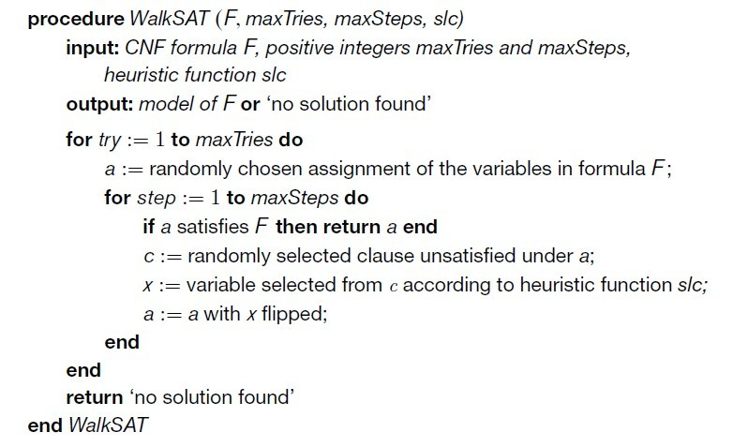

Slide 83
Adapt CDRW to subset problem
Sometimes the idea just doesn’t work directly, then abstract to a lower level and adapt it.
In local search for vertex cover problem, each step exchange two vertices, one is removed from the candidate solution, while another is added to the candidate solution.
Using conflict-directed random walk style, the adding vertex is always selected from an uncovered edge.

Slide 84
Tabu
Associate tabu attributes with solution components such as variables or vertices.
The solution component that change value recently are labeled ‘tabu’.
Forbids reversing the recent changes, by forbidding changing the value of the solution components labeled ‘tabu’.

Slide 85
Tabu for SAT
An FIFO queue: tabuList[]
Each step
a variable x not in tabuList is chosen to flip the value
Add x to tabuList
If (tabulist.size > tt) remove the first element of tabuList
Think: how to check whether a variable is tabu, by the age of a variable (so that we do not need tabuList)? (age(x): the number of steps since the last time x changed its value).

Slide 86
Note: Cycles of length at most m can be prevented by
tabu mechanism with tabu tenure tt=m.
Trade-off of choosing tt:
tt too low -> fail to prevent cycling
tt too high -> an excessive restriction of neighborhoods
Advanced TS methods:
Tabu with Aspiration
a variable can be chosen if its score is very large, regardless of whether it is forbidden by Tabu strategy;
Robust Tabu Search [Taillard, 1991]:
repeatedly choose tt from given interval;
Reactive Tabu Search [Battiti and Tecchiolli, 1994]:
dynamically adjust tt during search;

Slide 87
Adaptive Parameter
Typically, there are parameters control the diversification of local search, e.g., tabu tenure, random walk parameter.
To make the algorithms with parameters robust, we need adaptive parameter.

Slide 88
Reactive Tabu Search for MaxClique [Battiti and Tecchiolli, 1994]:
Record all found cliques by hash table.
If a clique is revisited during a short period, increase tabu tenure → enhance diversification
If no clique is revisited during a long period, decrease tabu tenure → enhance intensification

Slide 89
Adaptive Noise for SAT (Hoos 02)
The probability of performing a random step is controlled by a noise parameter wp (walking probability), which is adjusted during the search.
Parameter wp is initialized as 0;
If no improvement is observed during a long period, increase wp → enhance diversification: wp := wp + (1 − wp) · ϕ, where ϕ = 0.2;
If an improvement is observed, decrease wp →enhance intensification: wp := wp − wp · ϕ/2

Slide 90
Constraint Weighting (CSP)
Associate a number as the weight of each constraint, measuring the cost of violating this constraint.
The evaluation function is changed to the weighted version.
Constraint weighting in Iterative Improvement
When a constraint is violated, increase its weight by 1 .
The constraints with larger weight should be preferred to be satisfied.
Constraint weighting in Iterated Local Search
At local optima, increase weights of all violated constraints by 1
Making a local optimum no longer a local optimum during a period of time.

Slide 91
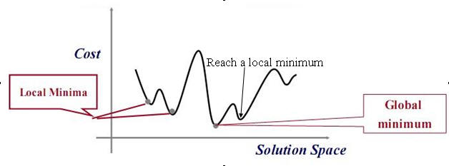

Slide 92
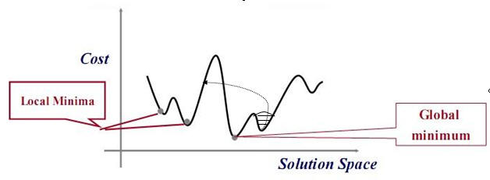

Slide 93
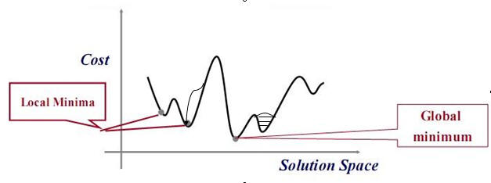

Slide 94
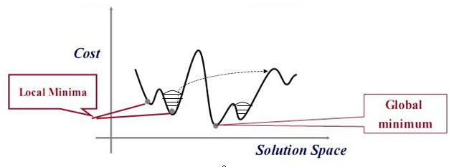

Slide 95
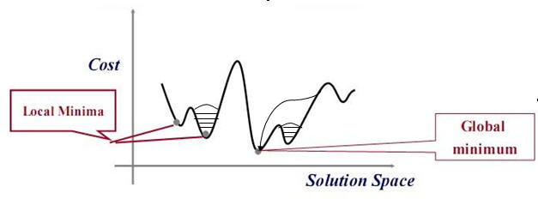

Slide 96
Clause Weighting for SAT
Date back to the Breakout method (1993): increases the weight of each unsatisfied clause by one when reaching local optima.
The Breakout method allows unrestricted weight growth during.
Modern clause weighting usually have a “smoothing” mechanism to decrease clause weights.

Slide 97
Clause Weighting for SAT
discrete Lagrangian method (DLM): DLM follows Breakout’s weight increment scheme, but additionally decrements clause weights by a constant amount after a fixed number of increases;
scaling and probabilistic smoothing (SAPS): when reaching a local optimum, with a fixed probability p, SAPS performs a random step; with probability 1 − p, the weights of all unsatisfied clauses are multiplied by a factor, and then, with a fixed probability, all clause weights are pulled towards their mean value using the formula w(c) = ρw(c) + (1 − ρ)w.
pure additive weighting scheme (PAWS): PAWS updates clause weights in local optima as follows. First, the clause weights of all unsatisfied clauses are increased by one; then, all clause weights are decreased by one after a fixed number of increases.

Slide 98
Component Weighting
Associate a number as the weight of each solution component, measuring the frequency of a solution component being selected.
Vertex Weighting for MaxClique (Pullan 06)
A GRASP framework: construction + local search
At the end of each local search phase, increase the penalty values of all vertices in the current clique, by one.
In the constructive phase, when selecting a vertex to add into the candidate solution, prefer vertices with lower penalty.

Slide 99
Scoring Functions
A basic Scoring Function
Previously, we introduced a scoring function for SAT, which is named ‘score’.
Under assignment S, score(x) = cost(S)-cost(S‘), where S’ differs from S only in the value of x, cost(S) is the number of unsatisfied clauses under S.
Other Scoring functions
age(x) = the number of steps since x has changed value
frequency(x) = a count on how many times x changes its value
wscore(x) = the weighted version of score, using clause weighting techniques
Score(x)+age(x)/T, where T is a parameter
…

Slide 100
Scoring Functions
A Scoring Function can be
a property of the variable, such as score, age, frequency …
any mathematical expression with one or more properties.
More Scoring functions
A^{score(x)}
score(x)^{B}
…
Dynamic Scoring functions
Change the parameters or the expression of the scoring function during the search

Slide 101
Further on Local Search

Slide 102
Theory
Practice

Slide 103
Theory of Local Search
Theoretical Aspects of Local Search, by Wil Michiels, Emile Aarts, and Jan Korst, 2007
Probability and Computing: Randomized Algorithms and Probabilistic Analysis, by Michael Mitzenmacher and Eli Upfal, 2005
Markov Chains

Slide 104
Theory of Local Search
Most theoretical works on local search are about simple local search methods like random walk
Many theoretical works about evoluationary algorithms, but few for general local search
Time complexity (running time analysis), performance guarantee
Prove the effectiveness or limitation of a certain technique in some local search frameworks

Slide 105
Practice
Implementation is very important
Read codes, and write codes, and you usually find something that you cannot expect to find in papers
Iterated Local Search is usually a good starting
If most techniques cannot improve your algorithm, either it is already sophisticated, or it is based on a 'wrong' framework
regression test

Slide 106
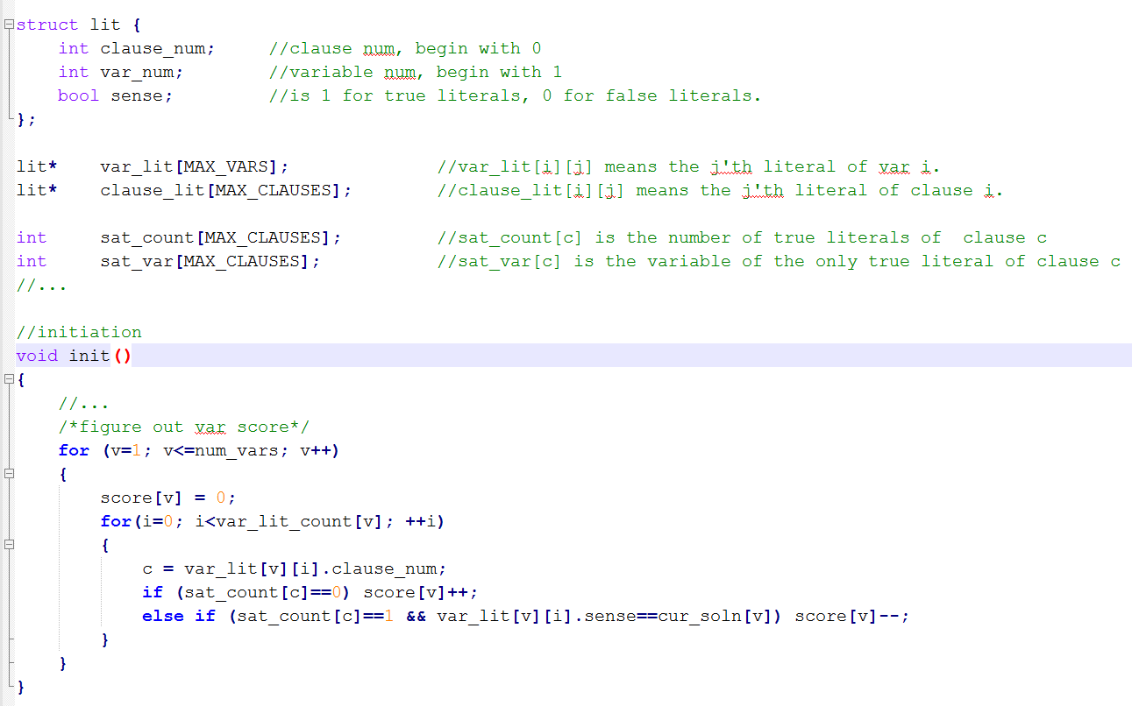
Caching based Score Computation

Slide 107
